Slide 1
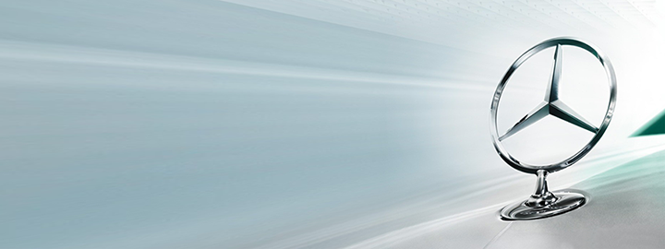


A Generative Statistical Model for Human Motion Synthesis
Han Du
Supervisor: Prof. Klakow & Prof. Slusallek
Advisor : Dr. Martin Manns
24.07.2014

Slide 2
Outline
Motivation
Objective
Background
Methodology
Implementation & Analysis
Summary & Future work

Slide 3
Outline
Motivation
Objective
Background
Methodology
Implementation & Analysis
Summary & Future work

Slide 4
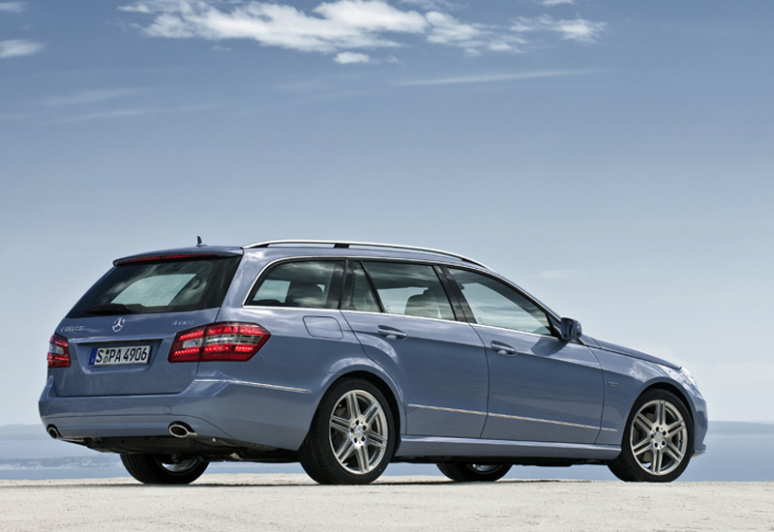
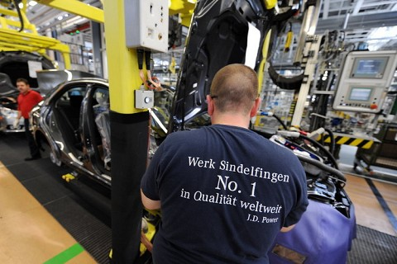
Motivation
Motivation
Goal:
High quality products
Efficient assembly and verification
Problems:
Traditional way of assembly planning and verification requires a physical prototype for each product
Construct physical prototype is time-consuming and costly
Solution:
Digital simulation and verification
Notes:
Now in the automotive industry, people want more kinds of products with high quality and efficient planning, assembly and verification procedures.
However, current solution is not sufficient to this requirement. The traditionary way of assembly planning and verification requires a physical prototype for each product.And constructing such a physical prototype is time-consuming and costly.
One promising solution for this problem is to use some digital simulation and vertification tools.

Slide 5
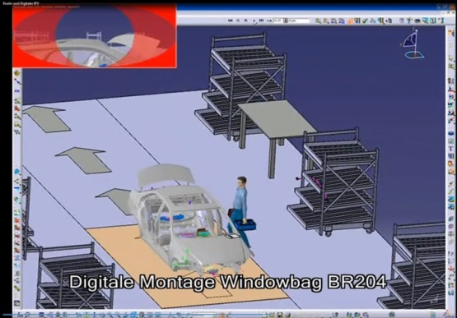
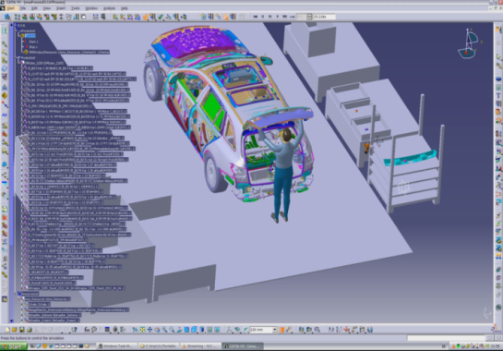
Digital Simulation and Verification
Motivation
Delmia V5
EMA from IMK-automotive GmbH
Initial situation:
Current digital simulation tools can interact with CAD product models, generate user specified actions to simulate assembly and verification tasks
Problem Statement:
Manually modeling time is high, one minute simulation could ask for several hours modeling work, e.g. Delmia V5
The quality of simulation is not sufficient: Unnatural, not accurate, unrealistic and collision awareness is bad , e.g. EMA

Slide 6
Outline
Motivation
Objective
Background
Methodology
Implementation & Analysis
Summary & Future work

Slide 7
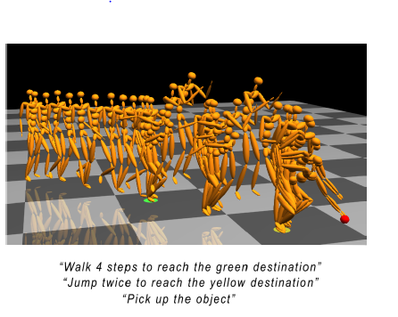
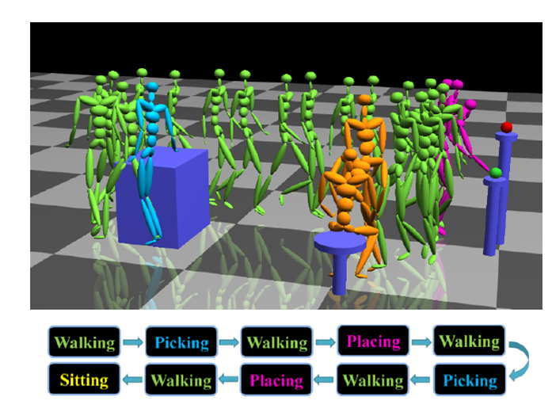
Objective
Objective
Semantic motion synthesis [1]
Reengineer Motion Graph++ algorithm for free space walking scenario
Evaluate the performance of this algorithm on noisy markerless motion capture data and a high quality motion capture data from Vicon system
[1] Min,J., Chai, J. Motion graphs++: a compact generative model for semantic motion analysis and synthesis. ACM Trans. Graph.31(6) 2012.

Slide 8
Outline
Motivation
Objective
Background
Methodology
Implementation & Analysis
Summary & Future work

Slide 9
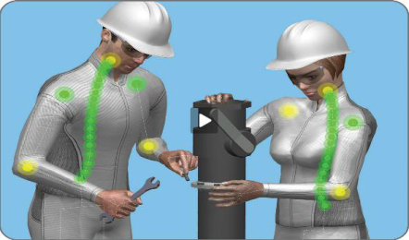
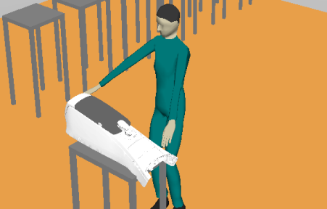
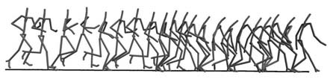
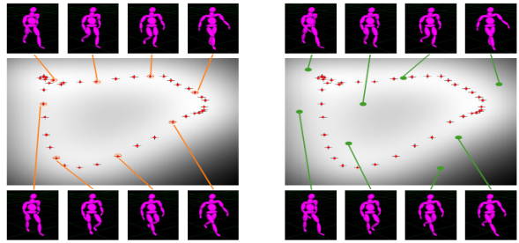
Motion Synthesis Methods
Background
Motion Synthesis
Parametric Motion Synthesis
MoCap Data driven Approaches
Motion Blending
Manual Synthesis
Motion Graphs
Statistical Modeling
Notes:
Manual geometric modeling: User needs to explicitly tune the parameters of human skeleton within physical-valid range to generate the simulation. However, the effort for modeling an accurate human motion is very high. For instance, one minute simulation could require several hours modeling. And the synthesized motion looks unnatural, like robots.
Analytic Motion Synthesis uses some analytic functions to control the change of parameters of human skeleton, so it doesn’t require much modeling work, and the parameters of functions can be learned from pre-record motion data. However, the result of synthesized motion is not good enough, not very realistic, bad collision detection.
With the development of motion capture techniques, now, people are more interested in mocap data driven motion synthesis methods, and a lot of researches have been done in this field.
The simplest way to generate new motions from pre-record motions is directly concatenating two motions, and blending and interpolating the transition point.
Motion Graphs transfers the motion synthesis problem into a graph search problem. It decomposes a long motion into small segments, and then generate new motions by re-connecting them.
Statistical model makes the assumption that although human motion could have infinite styles, they always follow some intrinsic patterns. So they try to use a statistical model to model the distribution of the structurally similar motions, and generate a new motion by sampling the statistical model.

Slide 10
Motion Synthesis Methods
Background
Motion Synthesis
Parametric Motion Synthesis
MoCap Data driven Approaches
Motion Blending
Manual Synthesis
Motion Graphs
Statistical Modeling
Notes:
Our approach is a combination of Motion Graphs and Statistical Modeling.

Slide 11
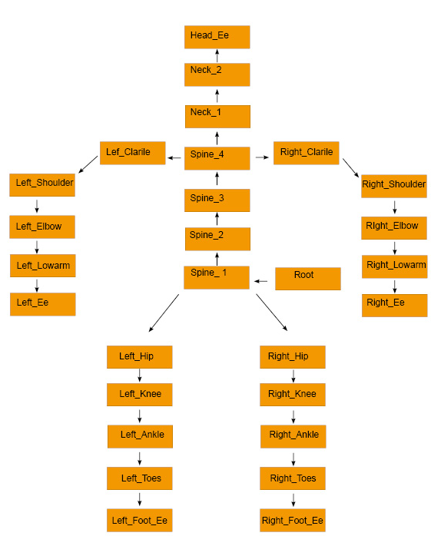
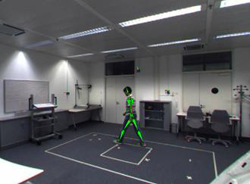
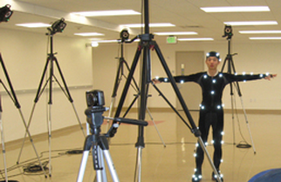
Motion Capture & Motion Data
Background
Markerless motion tracking system (MPII)
Human skeleton model (BVH files)
Vicon motion capture system (Vicon)

Slide 12
Outline
Motivation
Objective
Background
Methodology
Implementation & Analysis
Summary & Future work

Slide 13
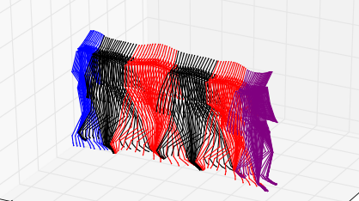
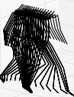
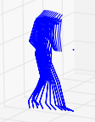

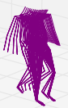
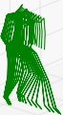
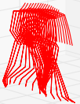
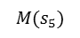
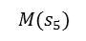
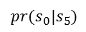
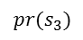
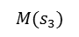
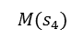
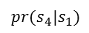
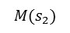
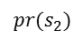
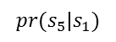
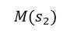
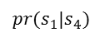
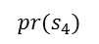
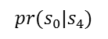
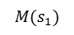
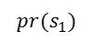
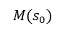
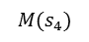
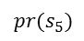
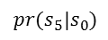
Motion Graphs ++
Methodology
$$M(s_{2})$$
$$pr(s_{2})$$
$$M(s_{0})$$
$$M(s_{4})$$
$$pr(s_{4})$$
$$pr(s_{0}|s_{4})$$
$$pr(s_{5}|s_{0})$$
$$pr(s_{0}|s_{5})$$
$$pr(s_{4}|s_{1})$$
$$pr(s_{1}|s_{4})$$
$$M(s_{0})$$
: right first starting
$$M(s_{1})$$
: left first starting
$$M(s_{2})$$
: right first walking
$$pr(s_{5})$$
$$pr(s_{5}|s_{1})$$
$$pr(s_{1})$$
$$M(s_{3})$$
: left first walking
$$M(s_{4})$$
: left first ending
$$M(s_{5})$$
: right first ending
$$M(s_{5})$$
$$M(s_{1})$$
$$M(s_{3})$$
$$pr(s_{3})$$
Transform motion synthesis problem to discrete directed graph search problem,
Decouple motion synthesis into two subtasks:
Find a graph walk/path
Generate new motion sample from each node and edge
Notes:
The idea of motion graphs++ is nearly the same as motion graphs, which also transfers the motion synthesis problem to discrete directed graph search problem.
Each node in the graph represents structurally similar motion segments (motion primitive).
Each edge in the graph reprensets possible transition between motion primitves.

Slide 14
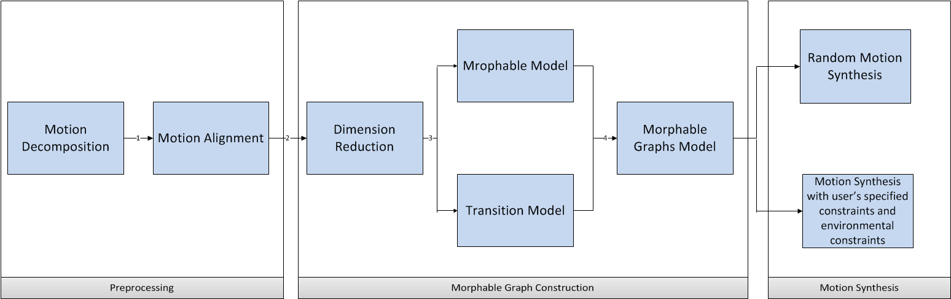
Procedure of Motion Graphs ++
Methodology

Slide 15
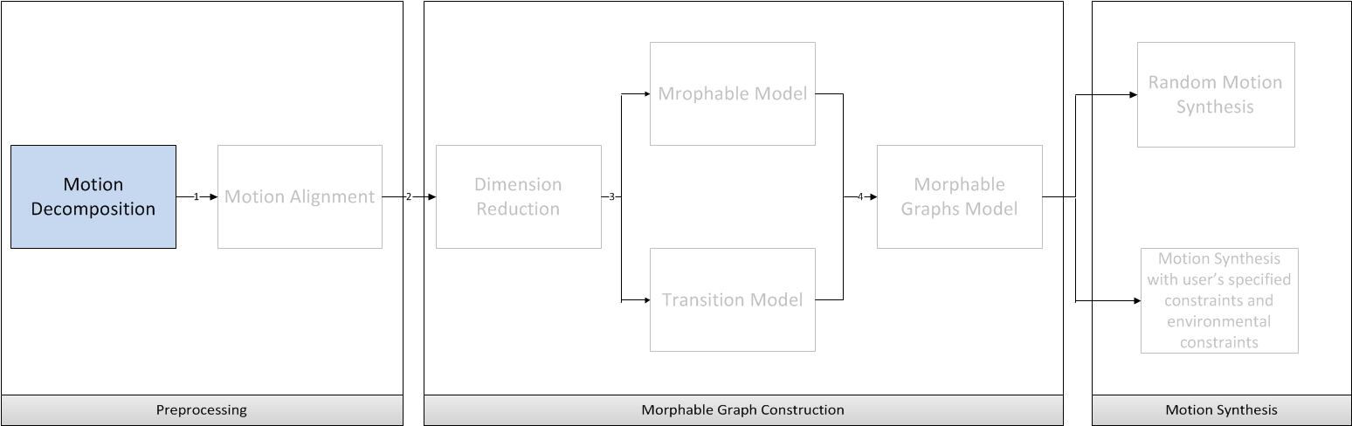
Procedures of Motion Graphs ++
Methodology

Slide 16
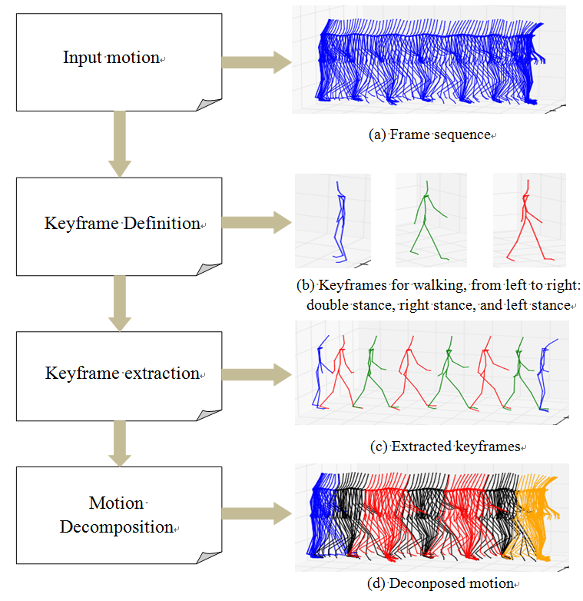
Motion Decomposition
Methodology
Target:
Decompose motion into structurally similar segments and group them into motion primitives.
Key Frame :
Contact state transitions occur
Highest visual content changes
Key Frame Extraction:
Manually label: Good result, but time-consuming
Automatic extraction:
Feature based extraction
Learning based extraction
Notes:
As I mentioned before, motion graph++ decouples motion sequence into several small motion primitives. Then, how to cut motion sequence ? For each kind of motion, We need to predefine the motion primitives of it. We can regard motion primitives as the special pose of motion and the transition between them. For instance, walking emerges as a sequence of alternating double and single-stance. So extract these special pose is actually extracting key frames from motion sequence. And we can use some features as indicator to extract key frames. Here, I use distance between two feet as the feature. When the distance between two feet reaches local maximum, it means one step ends.

Slide 17
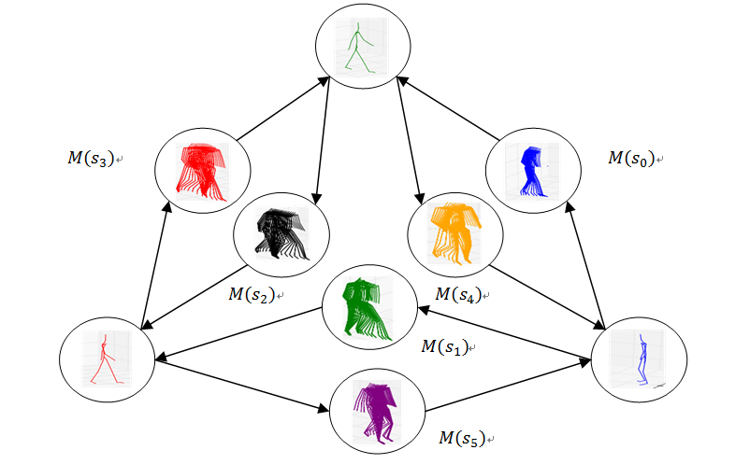
Motion Decomposition
Methodology

Slide 18
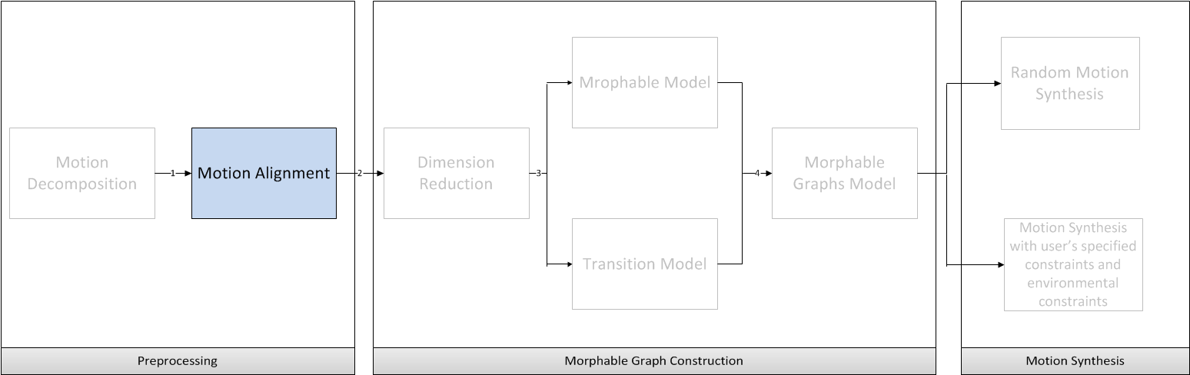
Procedures of Motion Graphs ++
Methodology

Slide 19
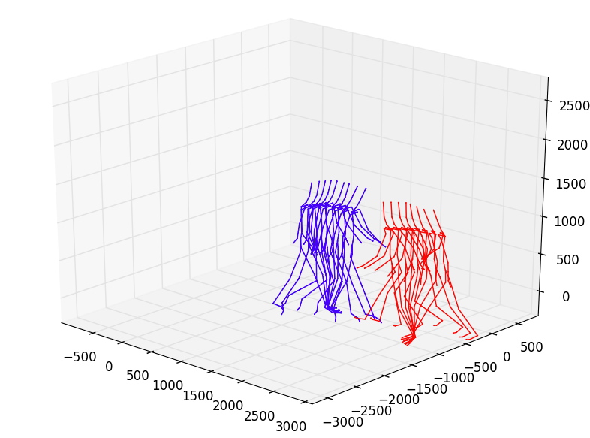
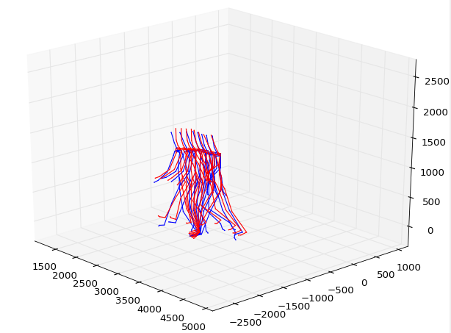
Motion Alignment
Methodology
Motivation:
Different motion segments could have different length and orientation
Target:
Warp different motion segments to a canonical timeline which is suitable for statistical analysis
[mm]
(a) Two motion segments before registration
[mm]
(b) Two motion segments after registration

Slide 20
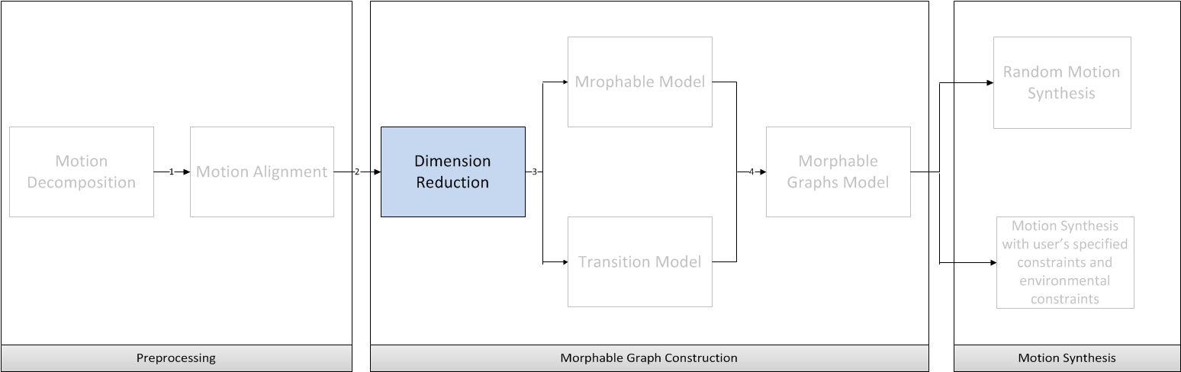
Procedures of Motion Graphs ++
Methodology

Slide 21
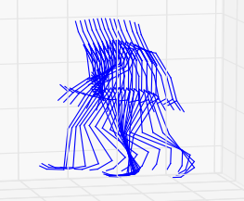
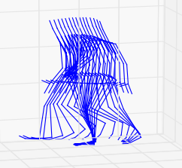

Dimension Reduction
Methodology
Aligned Motion Segments
High Dimensional Motion Vector(more than 5000 dimensions in our case)
Dimension Reduction (Principal Component Analysis)
Low Dimensional Motion Vector (less than 50 dimensions)
Statistical modeling
…

Slide 22

Procedures of Motion Graphs ++
Methodology

Slide 23









Morphable Model
Methodology
Statistical
Modeling
Structurally similar motion segments
Gaussian Mixture Model

Slide 24

Methodology
Morphable Model
Notes:
Each red point in the figure represents one motion segment in the same motion primitive. The gray color picture represents the Gaussian Mixture Model from training points. The bright area means high probability, and the dark area means low probability.

Slide 25

Procedures of Motion Graphs ++
Methodology

Slide 26

Transition Distribution Modeling
Methodology
Illustration of transition model based on Gaussian processes. models the distribution of transition from motion primitive to based on training data set D.

Slide 27

Procedures of Motion Graphs ++
Methodology

Slide 28




Morphable Graphs Model
Methodology

Slide 29

Procedures of Motion Graphs ++
Methodology

Slide 30




Random Motion Synthesis
Methodology
Find a graph walk in morphable graph
Generate motion samples from morphable model and transition model
…
…
…

Slide 31

Procedures of Motion Graphs ++
Methodology

Slide 32

Control Motion Synthesis
Methodology
Select most likely path of morphable nodes for user’s and environmental constraints
Find optimal parameters of each morphable mode and transition model
1
2
5
4
3

Slide 33
Outline
Motivation
Objective
Background
Methodology
Implementation & Analysis
Summary & Future work

Slide 34


Automatic Motion Decomposition
Implementation & Analysis
Automation of walking decomposition:
Key Frame Definition:
Feature Selection:
Absolute distance between two feet
Parameters Selection:
Stepsize: Step size over frame combines prior knowledge of motion, how many key frames in a short cut of frame sequence
Threshold: Threshold decides the sensitive of key frame extraction.
Double stance
Right stance
Left stance
Feature point
Threshold
Stepsize

Slide 35


Automatic Motion Decomposition
Implementation & Analysis
Quality Measure:
Definitions:
Correctly labeled key frame:
Automatically labeled key frame is very close to
manually labeled result, window size = 5
Wrongly labeled frame:
Automatically extracted frame is far away to any
manually labeled result
Test Data:
Markerless MoCap data: 145 “4 meter walking” files, 23467 frames in total
WiCon MoCap data: 2 files, 30993 frames in total
 | key frame | not key frame
labeled | true positives | false positives
not labeled | false negatives | true negatives
true positive (tp): correctly labeled key frames
false negative (fn): key frame, but not labeled
false positive (fp): labeled, but not key frame
True negative (tn): not key frame, and not labeled
Criteria:
Accuracy: $acc= \frac{tp+tn}{tp+fn+fp+tn}$
Distortion rate : $d= \frac{\sum_{i=1}^{N}{|I_{a}^{i}−I_{m}^{i}|}}{N}$
$I_{a}^{i}$: i-th correctly automatically labeled key frame
$I_{m}^{i}$: i-th corresponding manually labeled key frame
$N$ : total number of correctly labeled key frames

Slide 36


Automatic Motion Decomposition
Implementation & Analysis
Result Analysis:
Time Complexity:
Manually labeling time: ca. 8 hours
Automatic labeling time: ca. 10 minutes
Test Results:
Conclusion:
For simple motion, e.g. walking, running, one dominant feature works well
Feature-based automatic key extraction is better for high quality MoCap data
 | Markerless data | Vicon data
Acc | 100% | 100%
d | 2.3 | 0.9

Slide 37




Motion Alignment
Implementation & Analysis
: start point
: end point
Weighted Frame Distance:
Frame distance without weights
Algorithm optimizes fit of fit legs and arms. → Wrong rotation angles
Frame distance with weights
Motion will follow path of main body → Less influence of “unimportant” angles
(a) Root path of test motion
(b) Root path of reference motion
(c) Aligned without weighted distance
(d) Aligned with weighted distance

Slide 38



Dimension Reduction
Implementation & Analysis
Weighted Principal Component Analysis (WPCA):
Each joint has different importance in our hierarchical motion data structure.
Weight each joint inverse propositional to the level of hierarchy.
Synthesized result from conventional PCA
Weighted squared error between original data and projected data: (a) Markerless mocap data, (b) Vicon mocap data
Synthesized result from weighted PCA

Slide 39

Random Walking Synthesis
Implementation & Analysis
Random motion Synthesis example: ten steps straight line walking

Slide 40


Control Walking Synthesis
Implementation & Analysis

Slide 41
Outline
Motivation
Objective
Background
Methodology
Implementation
Summary & Future work

Slide 42
Summary
Summary & Future work
Statistical model is capable to model the distribution of motion and generate new variant motion.
Statistical approach for human motion synthesis is very sensitive to noise.
Statistical approach allows to convert controlled motion synthesis task as a optimization problem.

Slide 43
Future work
Summary & Future work
Visualization of animation and GUI to set a goal in XML3D
Synthesize walking motion to reach the goal
Find graph walk with random parameters in the Motion Graph++ to get as close as possible to that goal
Optimize kinematic parameters of the whole graph walk (slow numerical and fast analytical solution)
Control speed of the motion by additional time constraints for improved visual quality
Smoothing of transitions for improved visual quality

Slide 44
Reference
[1] Min,J., Chai, J. Motion graphs++: a compact generative model for semantic motion analysis and synthesis. ACM Trans. Graph.31(6) 2012.
[2] MIN, J., CHEN, Y.-L., AND CHAI, J. 2009. Interactive generation of human animation with deformable motion models. ACM Transactions on Graphics. 29(1): article No. 9.
[3] ARIKAN, O., FORSYTH, D. A., AND O’BRIEN, J. F. 2003. Motion synthesis from annotations. In ACM Transactions on Graphics.22(3):402–408.
[4] CHAI, J., AND HODGINS, J. 2005. Performance animation from low-dimensional control signals. In ACM Transactions on Graphics. 24(3):686–696.
[5] KOVAR, L., GLEICHER, M., AND PIGHIN, F. 2002. Motion graphs. In ACM Transactions on Graphics. 21(3):473–482.
[6] LAU, M., BAR-JOSEPH, Z., AND KUFFNER, J. 2009. Modeling spatial and temporal variation in motion data. In ACM Transactions on Graphics. 28(5): Article No. 171.
[7] MOLINA TANCO, L., AND HILTON, A. 2000. Realistic synthesis of novel human movements from a database of motion capture examples. In Proceedings of the Workshop on Human Motion.137-142.
[8] GROCHOW, K., MARTIN, S. L., HERTZMANN, A., AND POPOVIC´, Z. 2004. Style-based inverse kinematics. In ACM Transactions on Graphics. 23(3):522–531.

Slide 45

Thank you for your attention !

Slide 46


Slide 47
Chapter heading 45 pt on two lines
Additional text for chapter heading 15pt

Slide 48
Chapter heading 45 pt on two lines
Additional text for chapter heading 15pt

Slide 49
Table heading in CorpoS bold 15 pt
CorpoS Bold 15 pt | 1/05 | 2/05 | 3/05 | 4/05
CorpoS 15 pt | 1.256 | 2.554 | 1.480 | 2.004
Regular | 987 | 243 | 110 | 98
15 pt | 895 | 142 | 550 | 636
CorpoS | 1.457 | 1.598 | 1.224 | 1.108
Regular | 875 | 152 | 548 | 788
Line weight 0.5 pt | 1.337 | 1.618 | 1.194 | 1.472
Table captions are in CorpoS 9 pt and are placed 0.4 cm beneath the table.

Slide 50
Table heading in CorpoS bold 15 pt
CorpoS Bold 15 pt | 1/05 | 2/05 | 3/05 | 4/05
CorpoS 15 pt | 1.256 | 2.554 | 1.480 | 2.004
Regular | 987 | 243 | 110 | 98
15 pt | 895 | 142 | 550 | 636
CorpoS | 1.457 | 1.598 | 1.224 | 1.108
Regular | 875 | 152 | 548 | 788
Line weight 0.5 pt | 1.337 | 1.618 | 1.194 | 1.472
Table captions are in CorpoS 9 pt and are placed 0.4 cm beneath the table.

Slide 51
Table heading in CorpoS bold 15 pt
CorpoS Bold 15 pt | 1/05 | 2/05 | 3/05 | 4/05
CorpoS 15 pt | 1.256 | 2.554 | 1.480 | 2.004
Regular | 987 | 243 | 110 | 98
15 pt | 895 | 142 | 550 | 636
CorpoS | 1.457 | 1.598 | 1.224 | 1.108
Regular | 875 | 152 | 548 | 788
Line weight 0.5 pt | 1.337 | 1.618 | 1.194 | 1.472
Table captions are in CorpoS 9 pt and are placed 0.4 cm beneath the table.

Slide 52
Diagram headings are in CorpoS 9 pt and
are placed 0.4 cm beneath the diagram.

